Slide 1
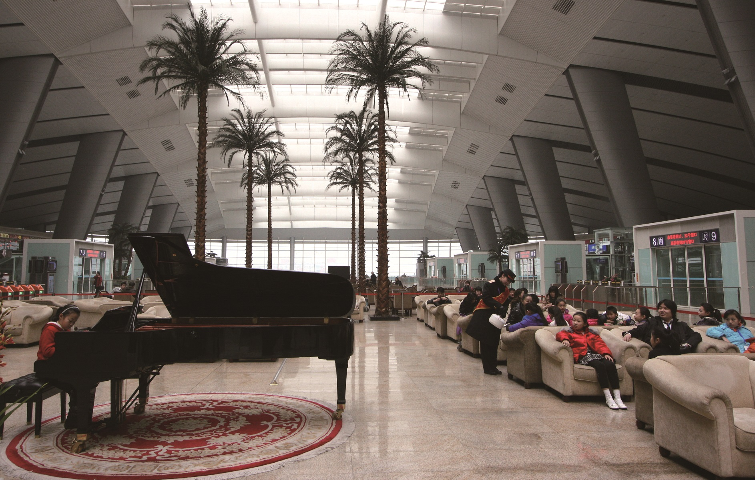
RESILIENT RAILWAY STATIONS
THNS2018

Slide 2

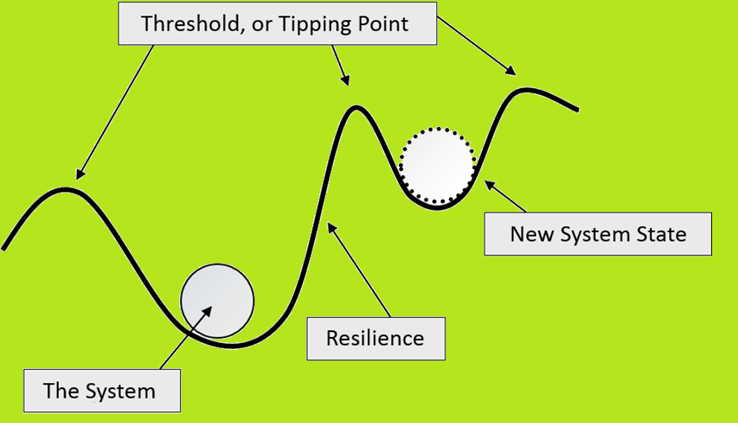
What’s Resilience?
Resilience is the ability to absorb disturbances, to be changed and then to re-organise and still have the same identity. It includes the ability to learn from the disturbance. A resilient system is forgiving of external shocks*.
Thrive
Survive
Adapt
Recover
* https://www.resilientcity.org/index.cfm?pagepath=Resilience&id=11449

Slide 3
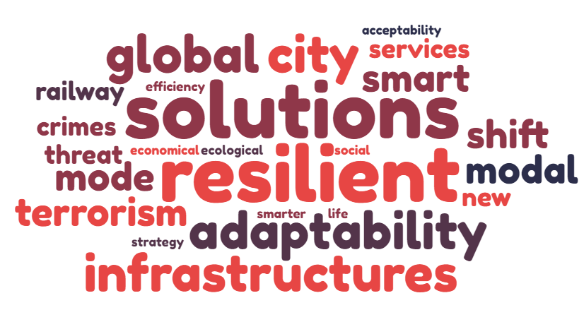
Why resilience is required for railway stations?
Challenges

Slide 4
Why resilience is required for railway stations?
Resilient Railway Stations
Basic functionnalities + Resilient actions + Smart Solutions
Sustainability
Avoid the depletion of natural resources and any form of negative impact (whatever it may be) in order to maintain the ecological balance and integrity of the city and its citizens.

Slide 5
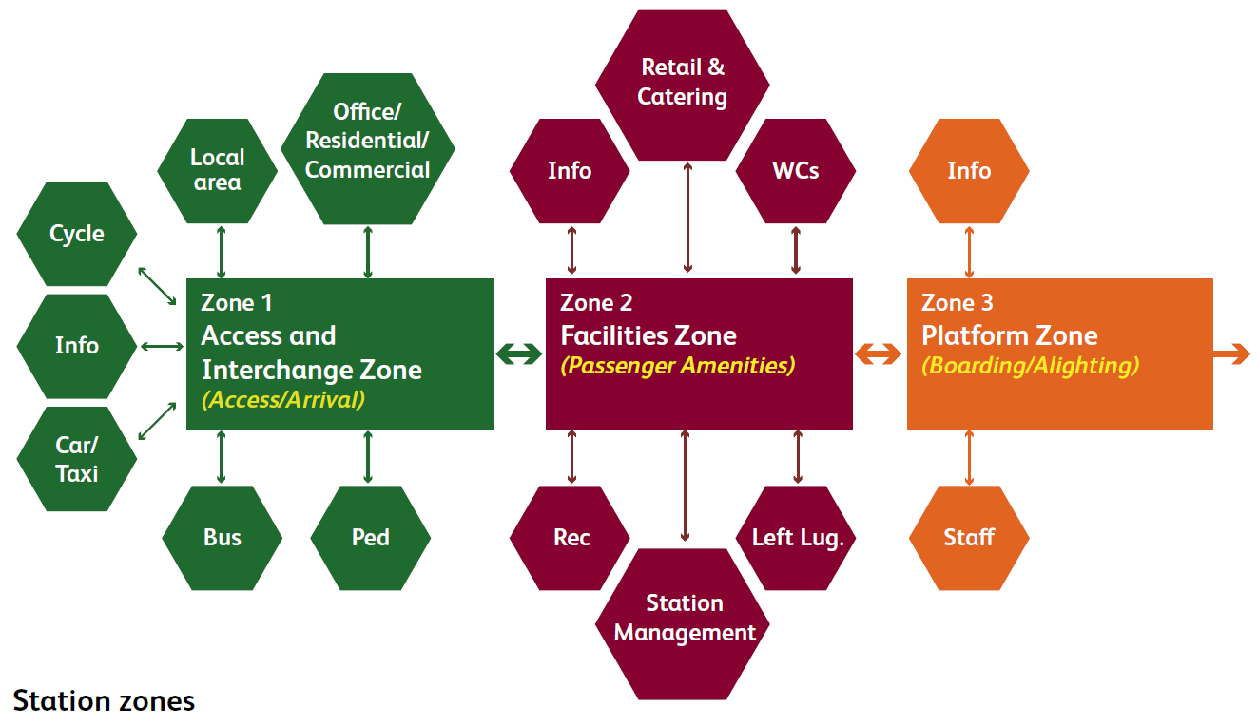
Basic functionalities of railway stations

Slide 6
Resilient actions for Railway Stations
Railway Stations
RESILIENT MANAGEMENT
RESILIENT PASSENGERS
RESILIENT
INFRASTRUCTURE
Readyness for disaster
Develop fundamentality assessment
Development of contengiency plan
Awarness and education
Approriation of the railway station as a public good
Defend Railway Stations from incivil act
Take into account future risks
Maintain the functionalities of the stations

Slide 7
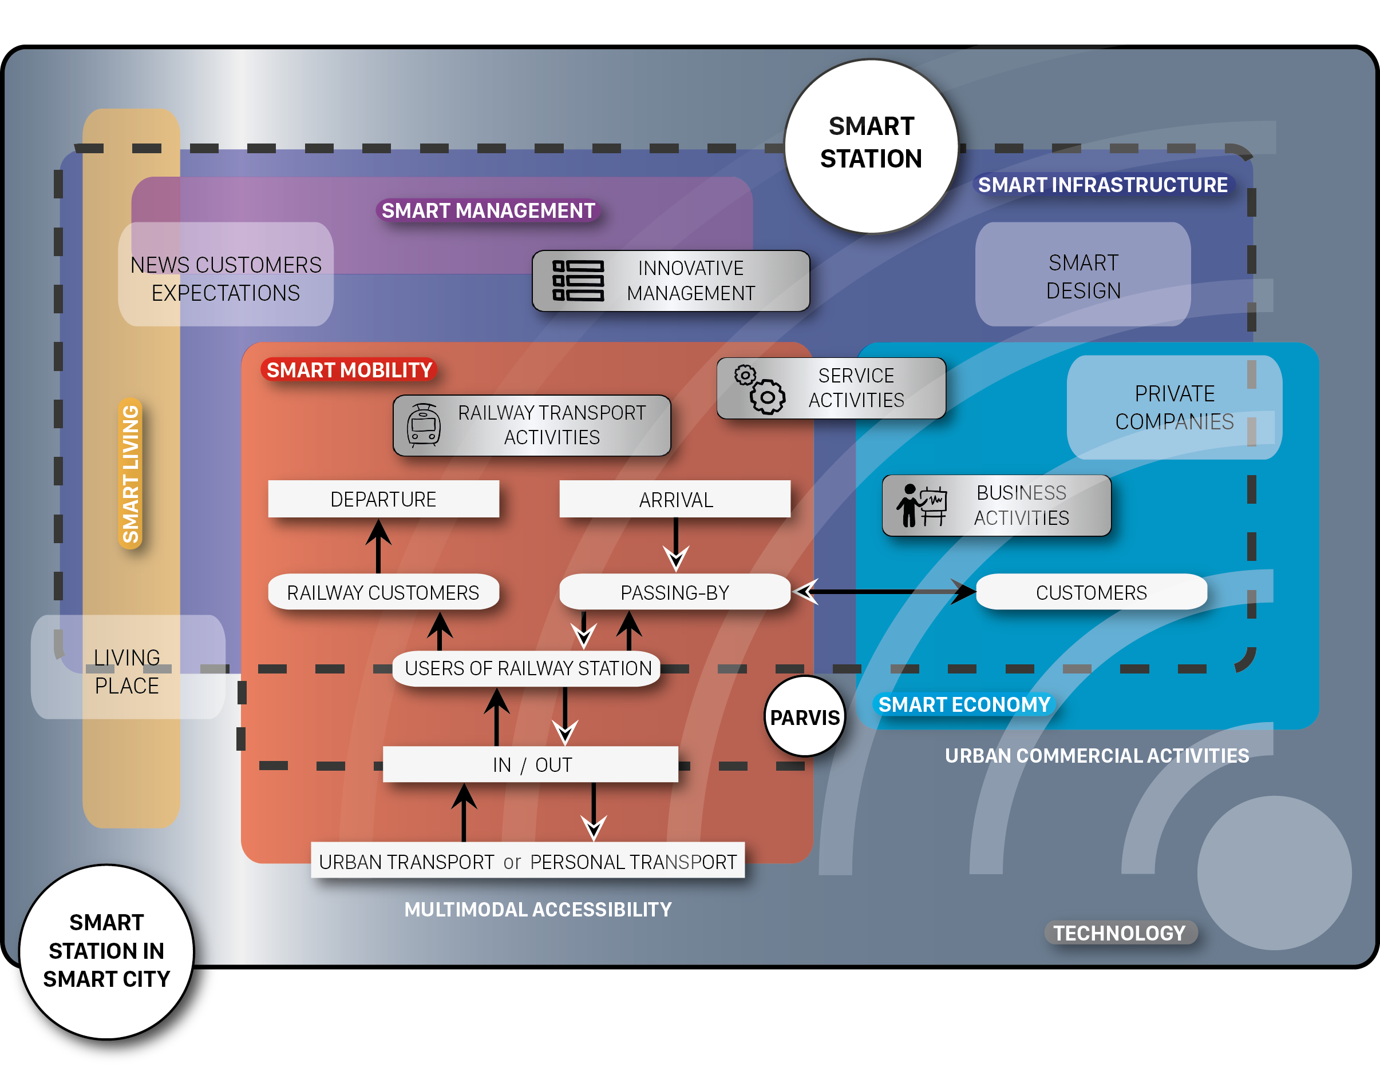
Smart Station for Smart Solutions

Slide 8
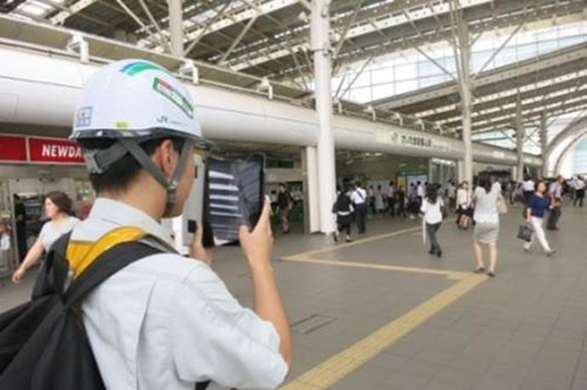
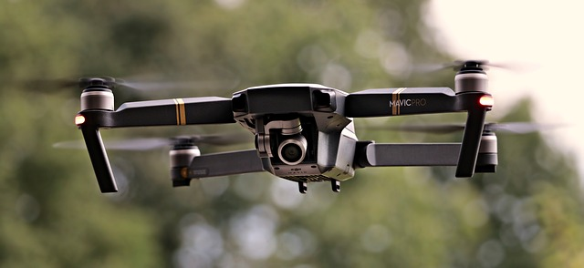
Smart Management
DEFINITION “The process of dealing with or controlling things or people with the new information and communication technology. The manager seeks constantly how improve his process, going beyond “classical” actions to create new opportunities and respond to new challenge”.

Slide 9
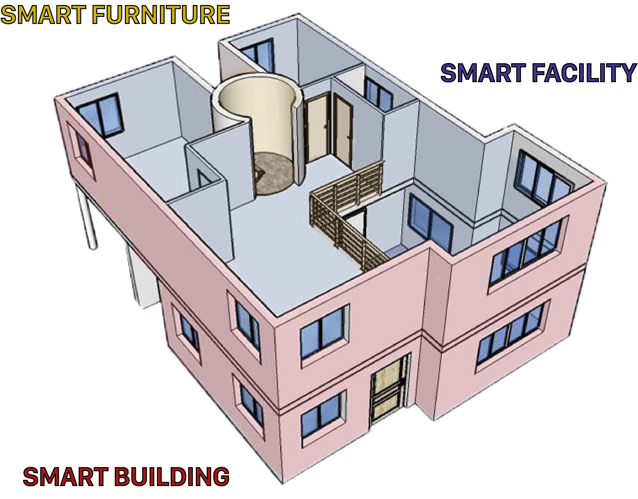
Smart Infrastructure
DEFINITION “Adding value, either through improved features, through for example better design or use of new technology”.
3 elements of railway infrastructure:
1/ Smart Building
2/ Smart Facility
3/ Smart Furniture

Slide 10
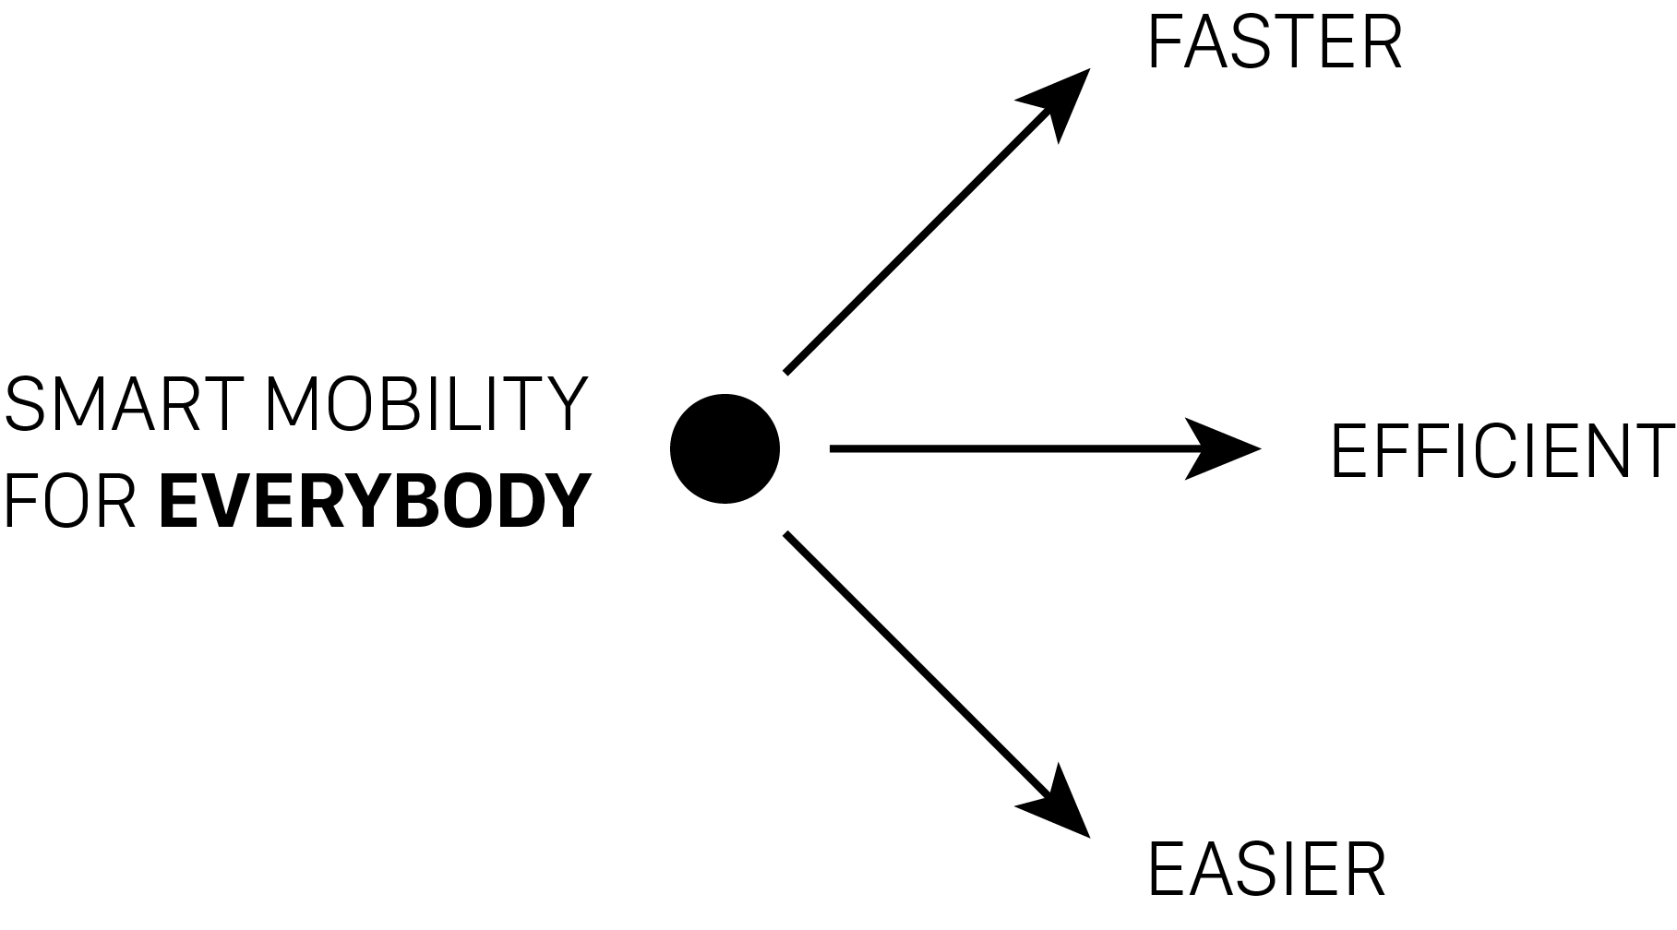
Smart Mobility
DEFINITION “Using new technology to facilitate flows of persons and information in time and space, using smart information and communication infrastructure”
Smart mobility as key for the new intermodality chain
Mobility as a service for shared mobility solutions
Digitalization ticketing system
Provide to people the key of their own mobility in all circumstances

Slide 11
Resilient Stations within Resilient Cities
Keep it minds
City is built by infrastructure, so we need develop Resilient Stations for Resilient Cities.
As railway stakeholders, we can’t miss the cooperation with local authorities.
The resilient station, a punctual concept, but whose values must be reflected in the urban and rural landscape of the cities for the coming decades.
One concept = X models

Slide 12

Thank you for your kind attention
谢谢
Mr. GUIGON Marc,
International Passenger Expert
Associates
Mr. GAUTIER Clément
Mr. SAADAOUI Amin

