Slide 1
铁路客运枢纽与城市功能互动关系 ——基于节点-场所模型的拓展分析 Interaction of Railway Passenger Transport Hub and Urban Function ——Analysis on Node-Place Model
第二十一届联合国气候大会边会第八届中法可持续发展城市交通系统论坛（THNS2015）
中国城市规划设计研究院 胡晶
2015年11月25日 法国巴黎
HU JING from China Academy of Urban Planning & Design
25/11/2015，Paris，France

Slide 2
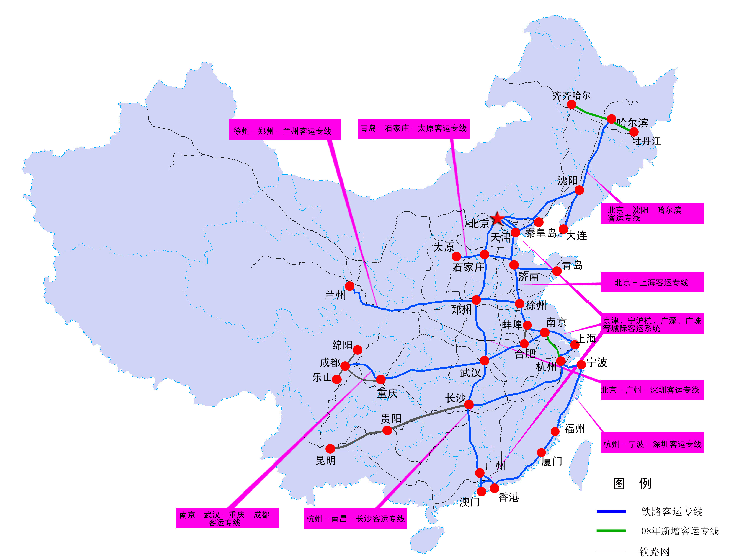
中国中长期铁路网规划（2008年调整） Long-term railway network plan of China（2008）
高铁时代的来临给中国铁路客运枢纽与城市功能的一体化发展带来新契机
With the advent of high-speed rail era, the integration of railway passenger transport hub and urban functions faces new opportunities in China.

Slide 3
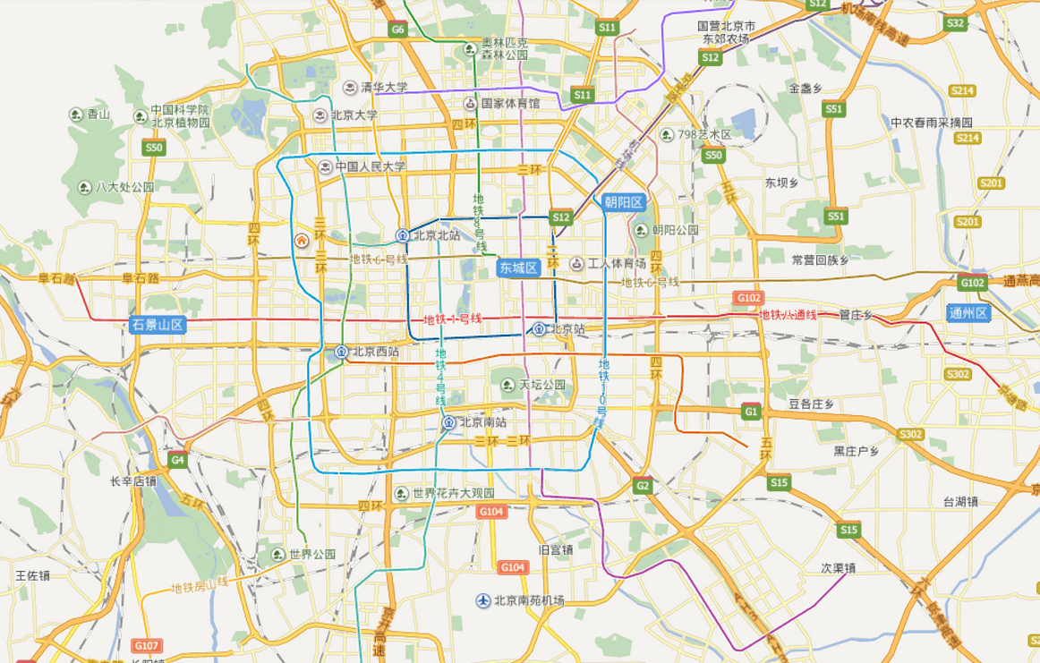
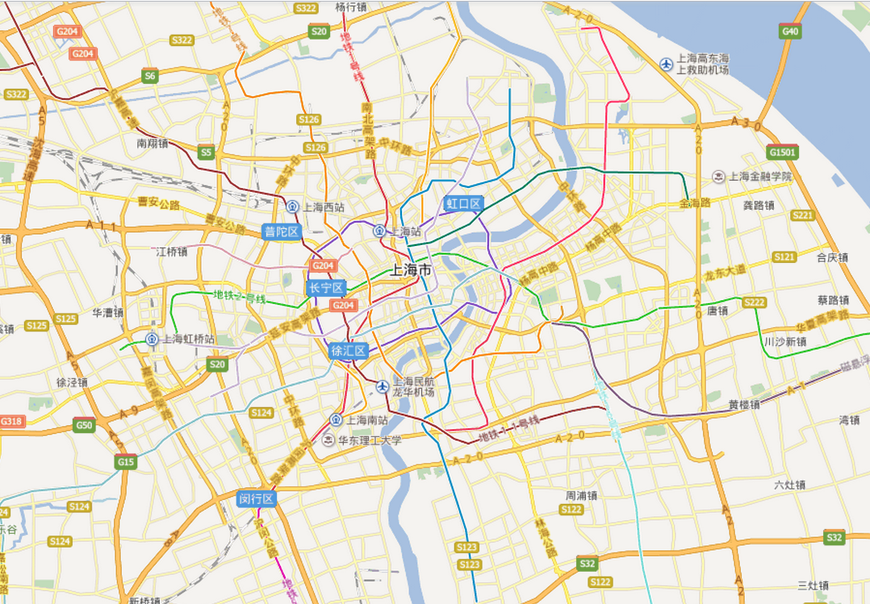
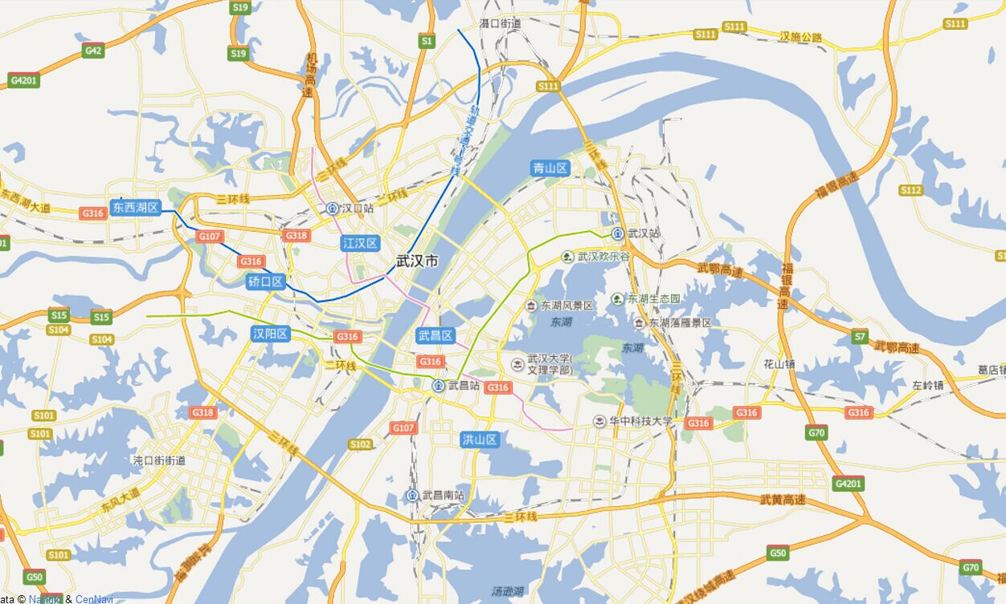
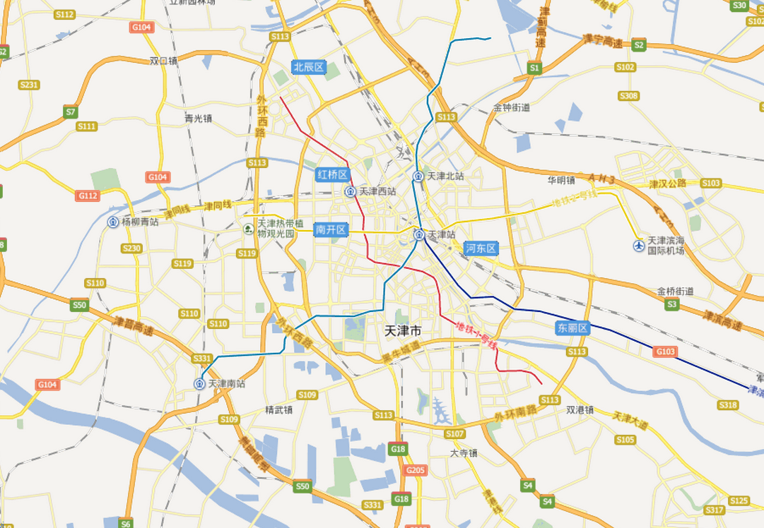
北京BEIJING
上海SHANGHAI
武汉WUHAN
天津TIANJIN

Slide 4
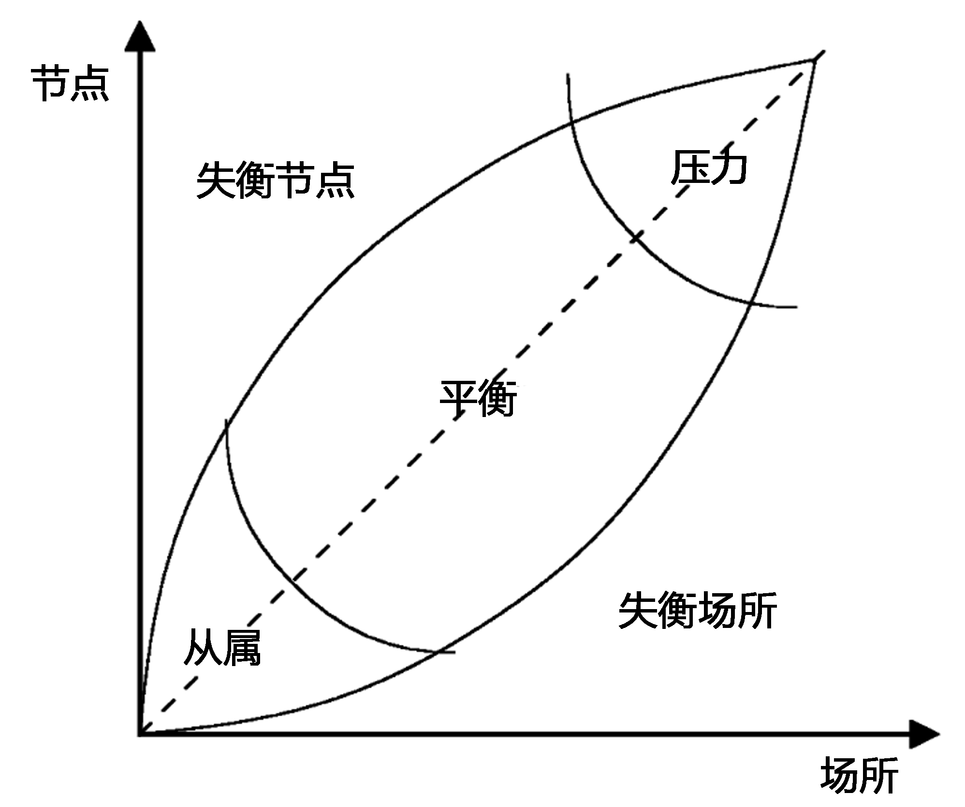
贝托里尼教授提出的节点-场所模型
Bertolini’s node-place model
Node
Unsustained node
Stress
Accessibility
Unsustained place
Dependency
Place

Slide 5
节点和场所应平衡发展，
交通节点是城市中心？
Nodes and places should be balanced development,so,
traffic node is the city center?

Slide 6
“节点-场所”模型的扩展研究：梅耶（Meijers，2002）
Applications（ Mejiers ，2002）
受托于荷兰经济事务部下属的NOVEM机构，对“节点-场所”模型进行了总结，并增加了第三个维度——站点地区的交往价值，研究指出：
国家交通节点政策应以创造作为物质空间以及空间功能、社会和制度网络节点的站点区位为目标。
Mejiers concludes that a national transportation node policy should be aimed at creating locations that are nodes in physical, as well as spatial-functional and social and institutional networks.
这一观点被目前的国家空间规划战略所采纳，国家空间规划战略文件中提到：
“在国家的城市网络中，创造易达的、有吸引力的城市中心并容纳多种功能与公共设施是至关重要的……尤为重要的是在基础设施节点周边发展城市中心”
This particular point has since become widely accepted as fro instance documented by the current National Spatial Planning Strategy.
This states that ‘In the national urban networks,the creation of easily accessible,attractive city centres with a variety of functions and public facilities is crucially important…It is particularly important to develop these city centres around infrastructure nodes’ （Ministry of Housing，Spatial Planning and the Environment，2006:9）

Slide 7
“节点-场所”模型的扩展研究：豪达佩尔·考芬(Goudappel Coffeng)顾问公司
Applications（ Goudappel Coffeng ）
指出“交通节点是城市中心”这一概念，并绘制了全国性的节点地图。其观点在《市政工程与水管理》中表述为：
“在城市中心区开发中，对于现有基础设施及其发展潜力的最优利用是首要目标之一。另一方面，当发展基础设施时，创造市中心服务设施的可能性也是可以预期的。”
In 2000 the consultancy from Goudappel Coffeng was asked by the Ministry of Transport,Public Works and Water Management to develop a national map of nodal areas in order to clarify the notion of the concept of the transportation node as an urban centre.
The Mobility Policy Document states in its turn: ‘during…downtown development, optimum utilization of the existing infrastructure and the potential of interfaces in this infrastructure is one of the primary goals. On the other hand, when developing infrastructure, possibilities for…creating downtown facilities are also anticipated’(Ministry of Transport,Public Works and Water Management,2006:9-10)

Slide 8
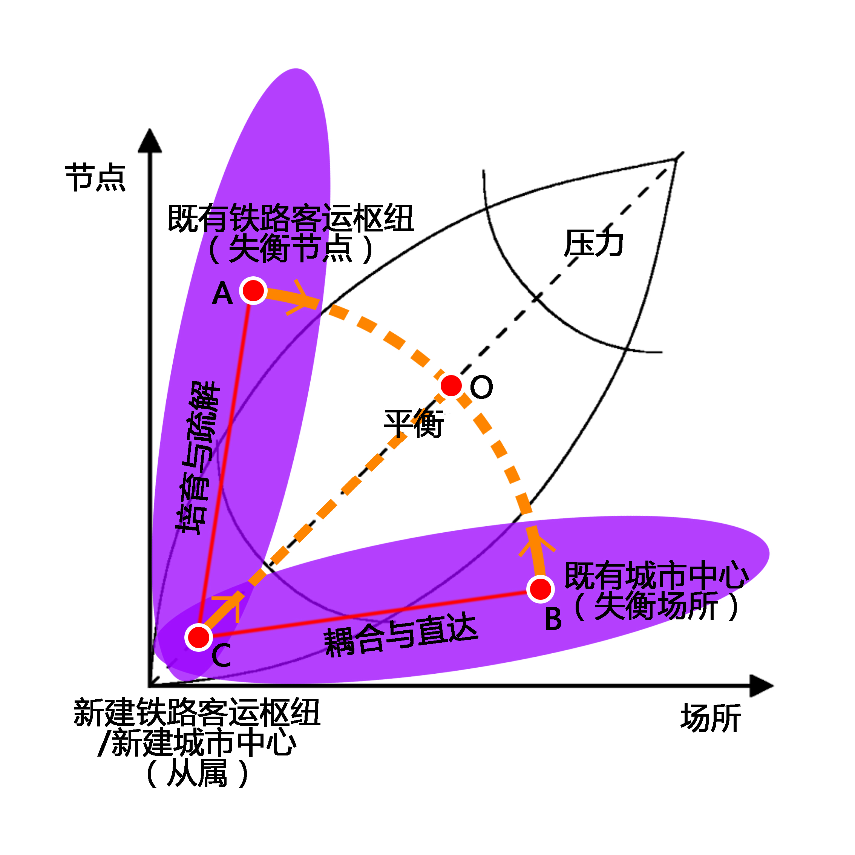
“节点—场所”扩展模型
Extensions of ‘node-place’model
两种变化：
流的变化：交通流的重构
场的变化：场所功能重组
三类地区：
既有铁路客运枢纽
既有城市中心
新建铁路客运枢纽/新建城市中心
Two Changes:
Changes in traffic flow
Changes in urban functions
Three Types Areas:
Exsiting railway passenger transport hub
Exsiting city center
Newly constructed railway passenger transport hub / Newly constructed city center
流的变化
Changes in traffic flow
Exsiting railway passenger transport hub (Unsustained node)
Node
Stress
Accessibility
场的变化
Changes in urban functions
Exsiting city center(Unsustained place)
Place
Newly constructed railway passenger transport hub / Newly constructed city center
(Dependency)

Slide 9
流的变化：交通流的重构
新建铁路客运枢纽与既有铁路客运枢纽的关系——培育与疏解
Changes in traffic flow：
The relationship of exsiting and newly constructed railway passenger transport hub——cultivate and ease traffic flow
流的变化
Changes in traffic flow
Exsiting railway passenger transport hub (Unsustained node)
Node
Stress
Beijing
Beijing railway station
Beijing west railway station
1978—2008年北京站和北京西站历年客运量
Annual passenger volume in Beijing Railway Station and Beijing West Railway Station during 1978—2008
场的变化
Changes in urban functions
Accessibility
Place
Beijing railway station/Beijing
Beijing west railway station/Beijing
Newly constructed railway passenger transport hub / Newly constructed city center
(Dependency)
1978—2008年北京站和北京西站客运量占全市铁路客运量比例
Proportion of the passenger volume to the total railway passenger volume in Beijing Railway Station and Beijing West Railway Station during 1978—2008

Slide 10
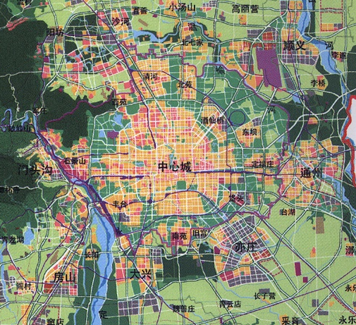
场的变化：场所功能重组
新建铁路客运枢纽与既有城市功能中心的的关系——耦合与直达
Changes in urban functions：
The relationship of exsiting and newly constructed urban center——integrated and direct contact
流的变化
Changes in traffic flow
Exsiting railway passenger transport hub (Unsustained node)
Node
Stress
主要居住功能区
主要服务功能区
铁路枢纽
场的变化
Changes in urban functions
清河、回龙观
Accessibility
天通苑
奥林匹克
望京
中关村
北京北站
Place
金融街
Newly constructed railway passenger transport hub / Newly constructed city center
(Dependency)
北京西站
CBD
北京站
通州
蒲黄榆
北京南站
北京的现状：
铁路枢纽全部位于城市中心，新城缺失
铁路枢纽与城市重要功能区全部不耦合
服务功能位于中心，居住功能位于新城
Current situation in Beijing
Railway passenger transport hub are located in the center of the city，and with no one in new district
Railway passenger transport hubs and urban important functional areas are located in different places
Service function is located in the center, and residential function is located in new district

Slide 11
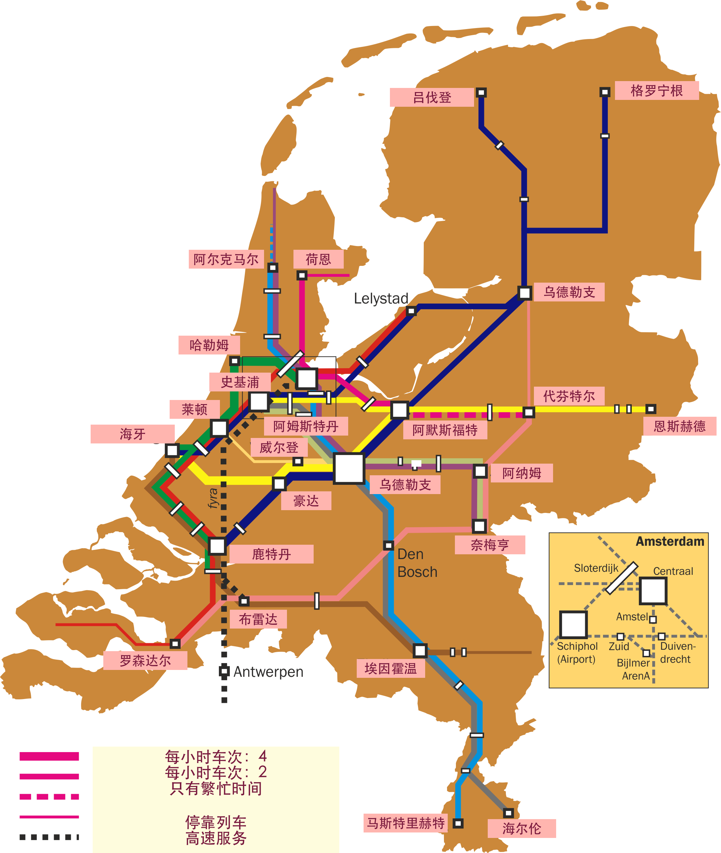
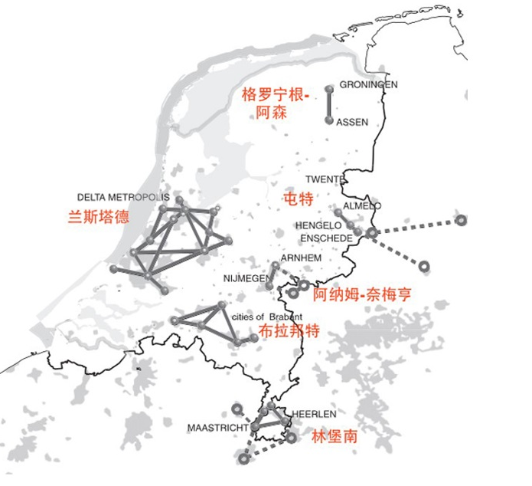
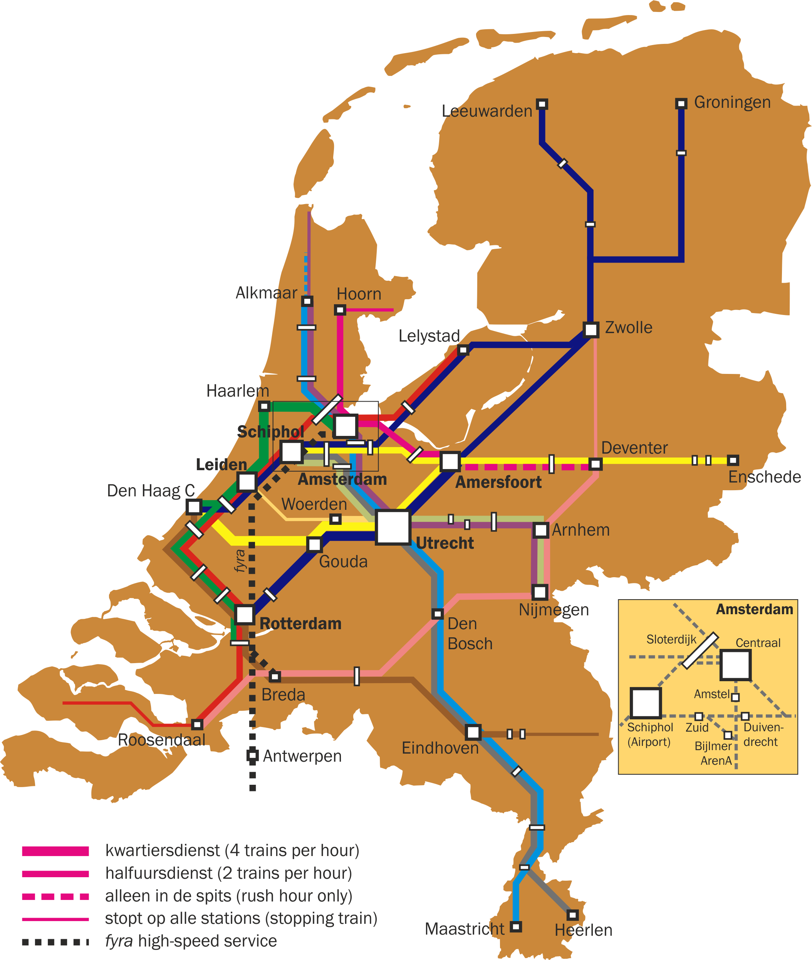
三类地区耦合发展新趋势：
失衡节点：既有铁路客运枢纽场所价值的提升
New trend of three types of regional coupling development: enhance the value of existing railway passenger transport hub
荷兰六个国家级网络分布
The six national networks and the relationship with the railway in the Netherlands

Slide 12
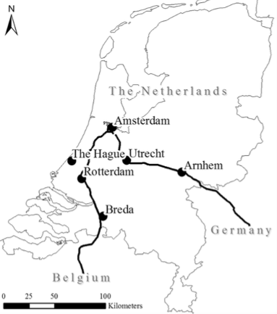
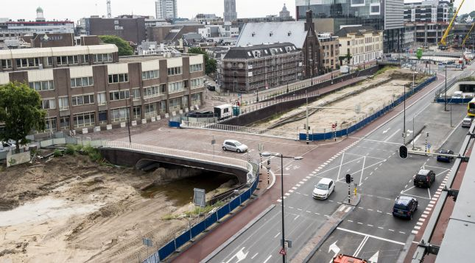
三类地区耦合发展新趋势：
失衡节点：既有铁路客运枢纽场所价值的提升
New trend of three types of regional coupling development:
Unsustained node :enhance the value of existing railway passenger transport hub
项目名称 name | 项目类型 type | 项目定位 orientation | 建设情况 Construction situation
阿姆斯特丹南站 Amsterdam Zuid railway station | 商务区改造 renovation of business district | 中央商务区，综合枢纽 central business district，integrated transport hub | 仍在扩建 Still expanding
鹿特丹中央车站 Rotterdam central railway station | 市中心改造 renovation of city center | 商务办公为主 Business office area | 已建成 Completed
乌德勒支中央车站 Utrecht central railway station | 市中心改造 renovation of city center | 上盖综合体，“CU2030”综合项目的一部分 A part of the upper cover complex, "CU2030" integrated project | 在建 being builded
海牙中央车站 The Hague central railway station | 市中心改造 renovation of city center | “new center”综合项目的一部分 A part of the "new center" integrated project | 已建成 Completed
阿纳姆中央车站 Arnhem central railway station | 市中心改造 renovation of city center | “Arnhem Centraal/Coehoorn”综合项目的一部分 Part of the "Arnhem Centraal/Coehoorn " integrated project | 已建成 Completed
布雷达车站 Breda railway station | 市中心改造 renovation of city center | 上盖综合体，“Via Breda”综合项目的一部分 A part of the "Via Breda" integrated project on the upper cover | 在建 being builded
荷兰六个国家级新关键项目基本情况
Basic situation of the six new key projects in the Netherlands
CU2030

Slide 13
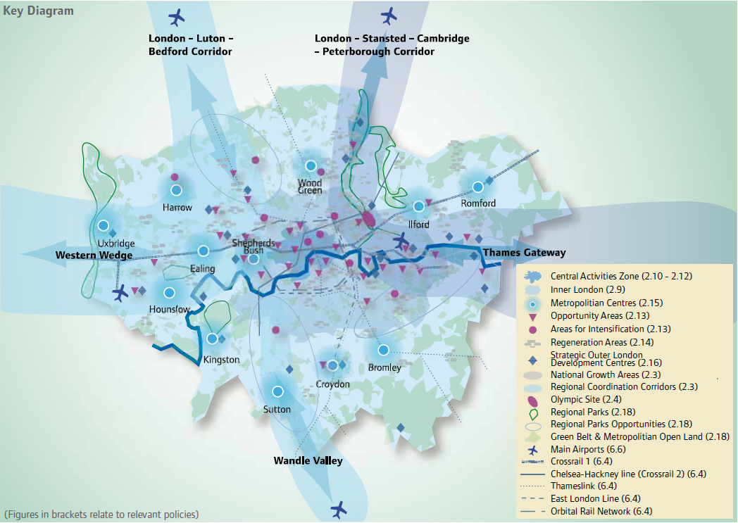
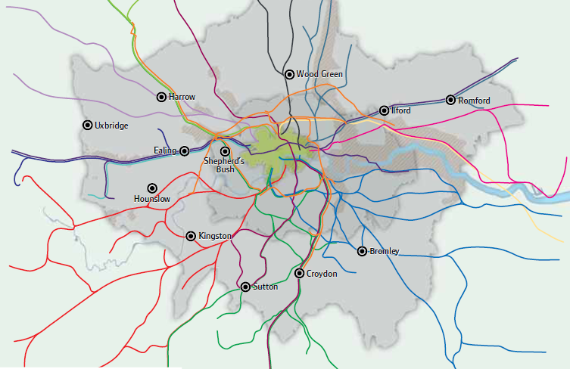
三类地区耦合发展新趋势：
失衡场所：城市中心节点价值的提升
New trend of three types of regional coupling development:
Unsustained place :enhance the value of city center node
伦敦Crossrail工程（2009-2017）：面向区域强化中心
Crossrail project in London （2009-2017） : strengthen urban centers in the region

Slide 14
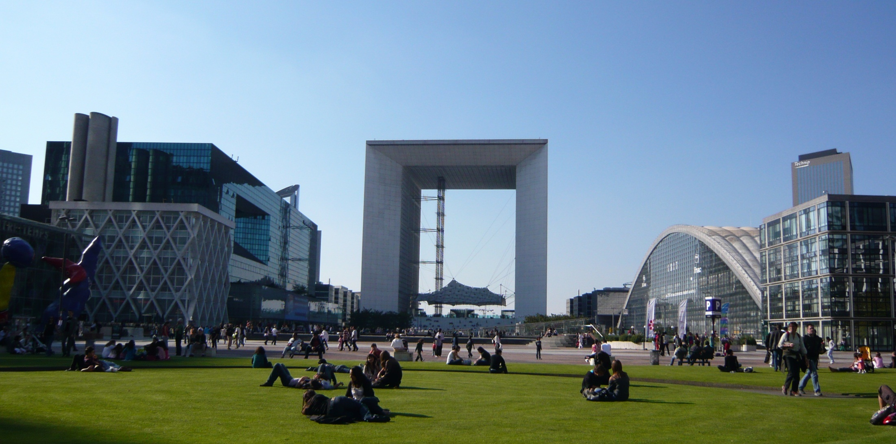
三类地区耦合发展新趋势：
从属状态：利用新建铁路客运枢纽构建新的城市中心
New trend of three types of regional coupling development:
Dependency : construct new city center by using new railway passenger hub
拉德芳斯La Defense

Slide 15
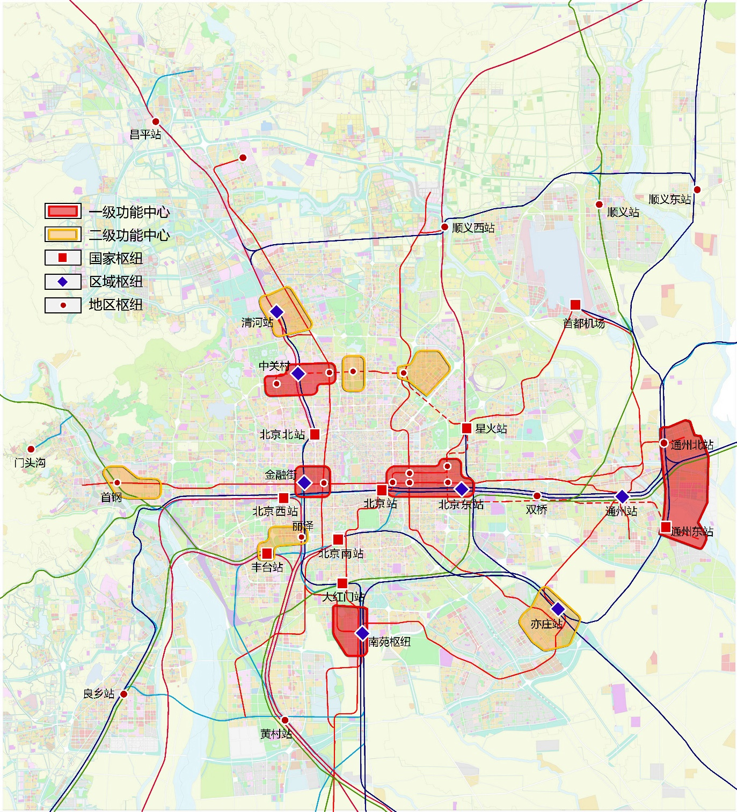
模型的应用：北京铁路客运枢纽与城市功能的关系构想
Application of the model: the relationship between Beijing railway passenger transport hub and urban function
针对三类地区的策略Strategies for the three types of areas
失衡节点：落实城市功能疏解政策，提升公共空间品质
北京站、北京西、北京南、北京北
Unsustained node : ease city function and improve the quality of public space
失衡场所：在城市既有公共中心引入节点功能
金融街站、北京东站（CBD站）、中关村、望京西、奥体站地区
Unsustained place : increase node function to the existing city centers
从属状态：结合交通枢纽建设，构建新的城市中心
通州东站及北站地区、南苑地区、清河、 亦庄、丰台丽泽、首钢
Dependency：combine transport hub and city center, to cultivate new center in new district
Changping
SHUNYI EAST
first-level functional center
Secondary functional center
National hub
Regional hub
District hub
SHUNYI
SHUNYI WEST
QINGHE
CAPITAL INTERNATIONAL AIRPORT
ZHONGGUANCUN
BEIJING NORTH
XINGHUO
TONGZHOU NORTH
MENTOUGOU
TONGZHOU
SHOUGANG
BEIJING EAST
BEIJING WEST
BEIJING
SHUANGQIAO
LIZE
BEIJING SOUTH
TONGZHOU EAST
FENGTAI
DAHONGMEN
NANYUAN
YIZHUANG
NIANGXIANG
HUANGCUN

Slide 16
三类地区 three types of areas | 代表车站 Typical Station | 节点node |  | 场所place
 |  | Transit connection 对外交通 | Transfer Facilities 对内交通 | Spatial Development 功能发展 | Urban Design 空间设计
失衡节点Unsustained node | 北京站、北京西、北京南、北京北 Beijing railway station，Beijing west railway station ，Beijing south railway station，Beijing north railway station | 疏解交通功能，缓解压力 快速化、短途化、高端化 Reduce traffic function Fast, short distance, high-end | 增加轨道交通分担比例70% 增加步行换乘 细化停车空间改造与管理（限制长期停车） Increase the proportion of rail transport to 70% Encourage walking Refinement parking space transformation and management (limited long-term parking) | 以城市客厅的景观环境功能为主 Create comfortable urban landscape，like the living room of the city | 以人为本、标志性的开放空间体系 与周边环境的连接与融合 换乘空间的舒适化 people oriented and markable open space Connection and integration with the surrounding environment Comfortable transfer space
失衡场所 Unsustained place | 金融街站、北京东站（CBD站）、中关村、望京西、奥体站地区 Financial Street railway station，Beijing east railway station（CBD), Zhongguancun railway station，Wangjing west，Olympic Center | 增加城际、市郊快线供给 快速化、短途化、高端化 Increase intercity railway and suburban Express Fast, short distance,high-end | 保证轨道交通分担比例80% 鼓励步行换乘 限制机动车停车 Increase the proportion of rail transport to 80% Encourage walking Parking restriction | 补充商业休闲、公寓等功能，平衡地区发展 supply commercial leisure, apartments and other functions, to ensure balanced regional development | 连续的立体步行系统 换乘空间的舒适化 Continuous stereo walking system Comfortable transfer space
从属状态 Dependency | 通州东站及北站地区、南苑地区、清河、 亦庄、丰台丽泽、首钢 Tongzhou east and north railway station，Nanyuan，Qinghe，Yizhuang，Lize，Shougang | 建立多点对外的枢纽体系 发挥综合枢纽的集聚优势(长途、公交的组合布局） Establish a multi point external hub system Layout long distance bus station, bus terminal, forming a comprehensive transportation hub | 鼓励轨道交通换乘50% 鼓励公共交通换乘 鼓励步行（自行车）的便捷换乘 差异化的机动车停车政策 Increase the proportion of rail transport to 50% Encourage public transport Encourage walking Parking restriction Differentiated motor vehicle parking policy | 结合片区发展确定主体功能 鼓励混合功能与职住平衡发展 对远期功能的弹性预留 determine the main function according to regional development encourage mixed function and residence-employment balance Elastic reservation for forward function | 以人为本连续的城市空间 换乘空间的便捷与有序 与城市功能的合理整合 小街坊、密路网的空间格局 people oriented Convenient and orderly transfer space Reasonable integration with urban functions The spatial pattern of small neighborhood and dense road network

Slide 17
谢谢
Thanks
Merci
中国城市规划设计研究院 胡晶
电话：008618610296420
邮箱： hujing_caupd @ 126.com
通讯地址：北京市海淀区车公庄西路10号中国城市规划设计研究院
Jing hu，from China Academy of Urban Planning & Design
Tel:008618610296420
E-mail:hujing_caupd @ 126.com
Address:10th chegongzhuang west road，haidian district，Beijing，china

